Slide 1


Slide 2
TEAMMATES
Hussein Abumelih – Scrum Trainer
Teodor Angelov – Back End Developer
Stephan Stratev – Front End Developer
Alexander Yanev – Quality Engineer

Slide 3

Contents
1.Topic
2.Summary
Goal
Main stages in accomplishment of the project:
Planning
Realization
4.Going through the code
Time management
3.Main problems during realization
Working with files

Slide 4
Summary

Slide 5

Goal
Goal - our goal was to create a useful program that organizes and creates teams.

Slide 6
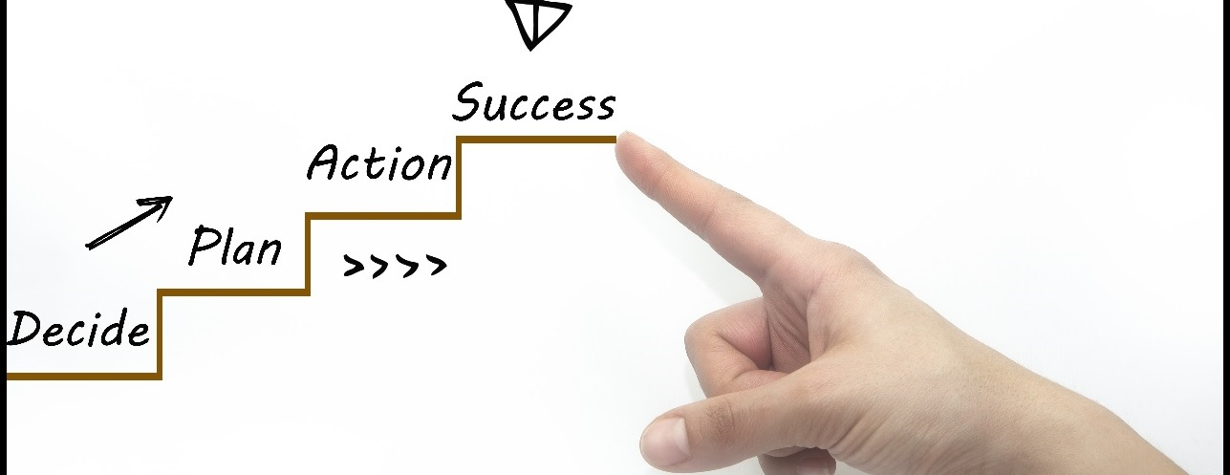
Main stages in accomplishment of the project

Slide 7

Difficulties during realisation

Slide 8
Going through the code

Slide 9
THANK YOU FOR YOUR ATTENTION!

